Slide 1
Weekly meeting 14
Shengya Guo, CR/AVS3, 02.10.2024

Slide 2
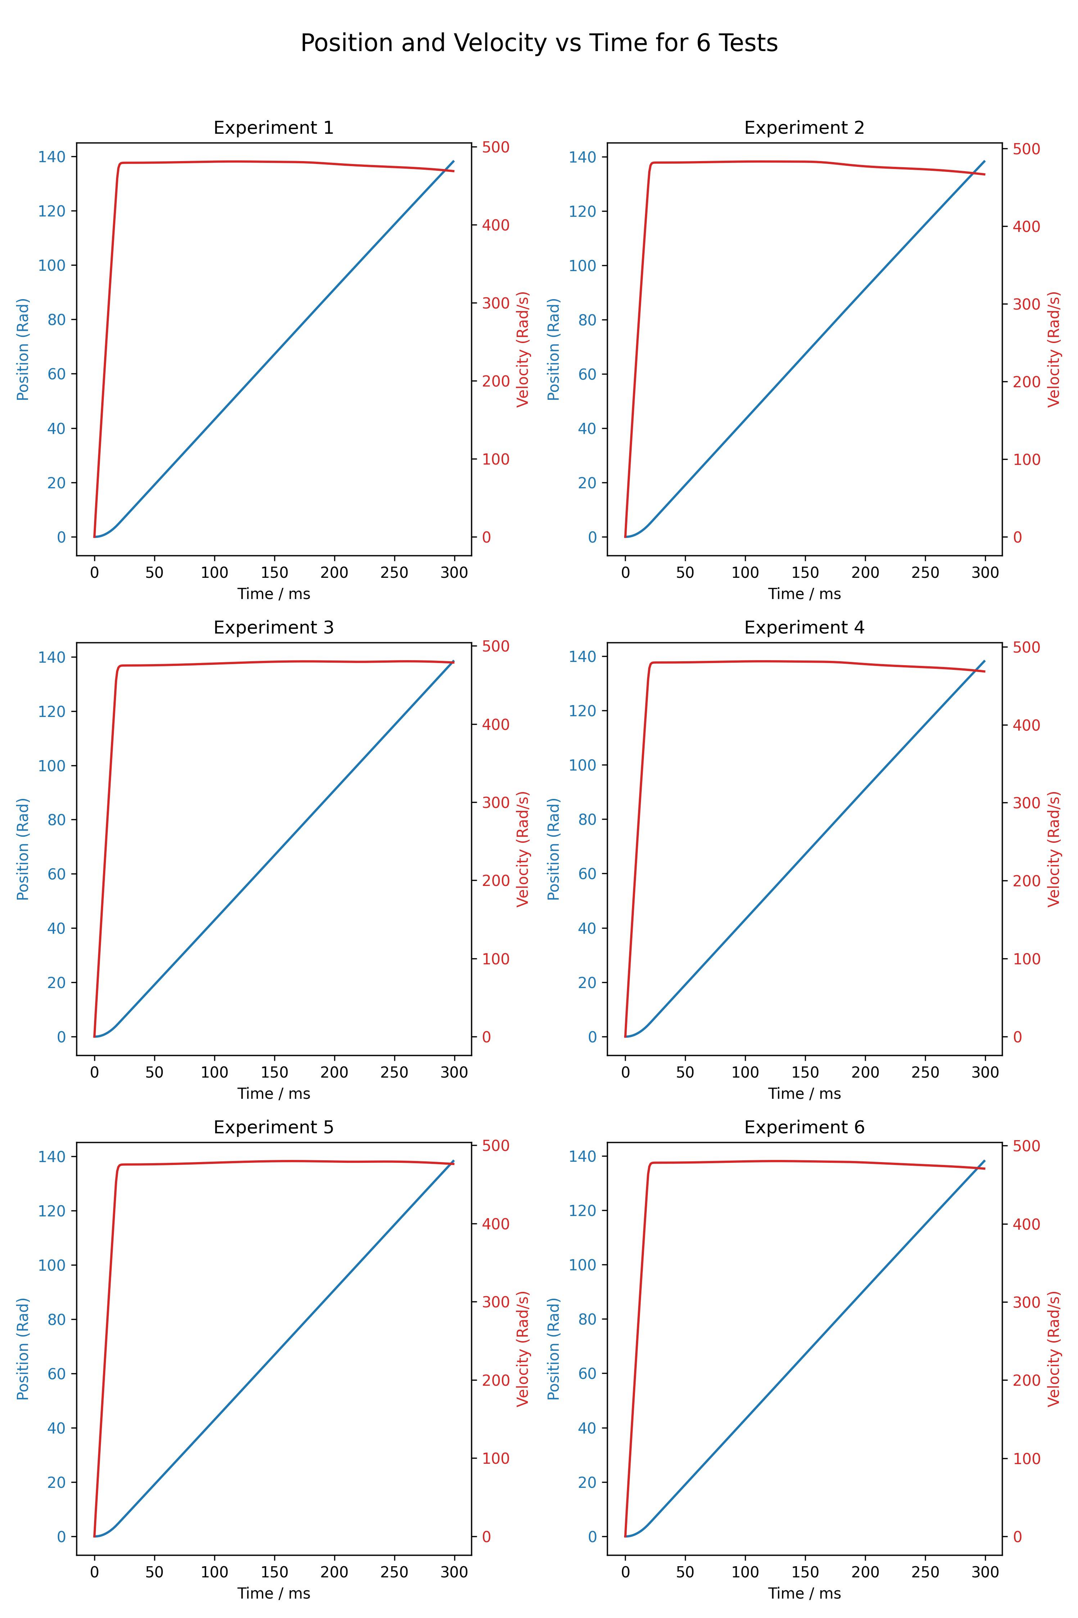
With the old EMB model, no noise in obs
Free the restriction of the position

Slide 3
Noise in obs added
x0_noise = x0_new + np.random.normal(0, self.pos_std)
x1_noise = x1_new + np.random.normal(0, self.vel_std)
pos_std = 1e-3
vel_std = 1

Slide 4
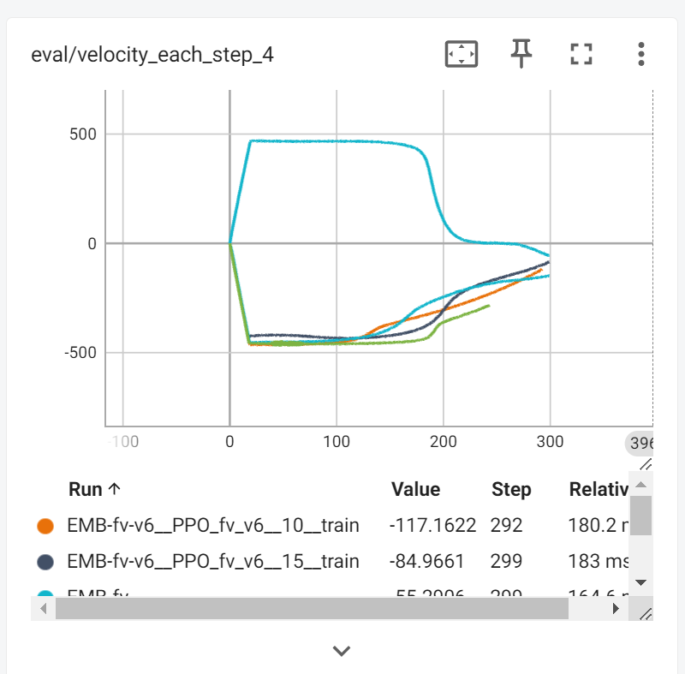
Train 5 times with different seed
Only when seed=1 the EMB drive forward
All other seed the EMB drive in other direction

Slide 5
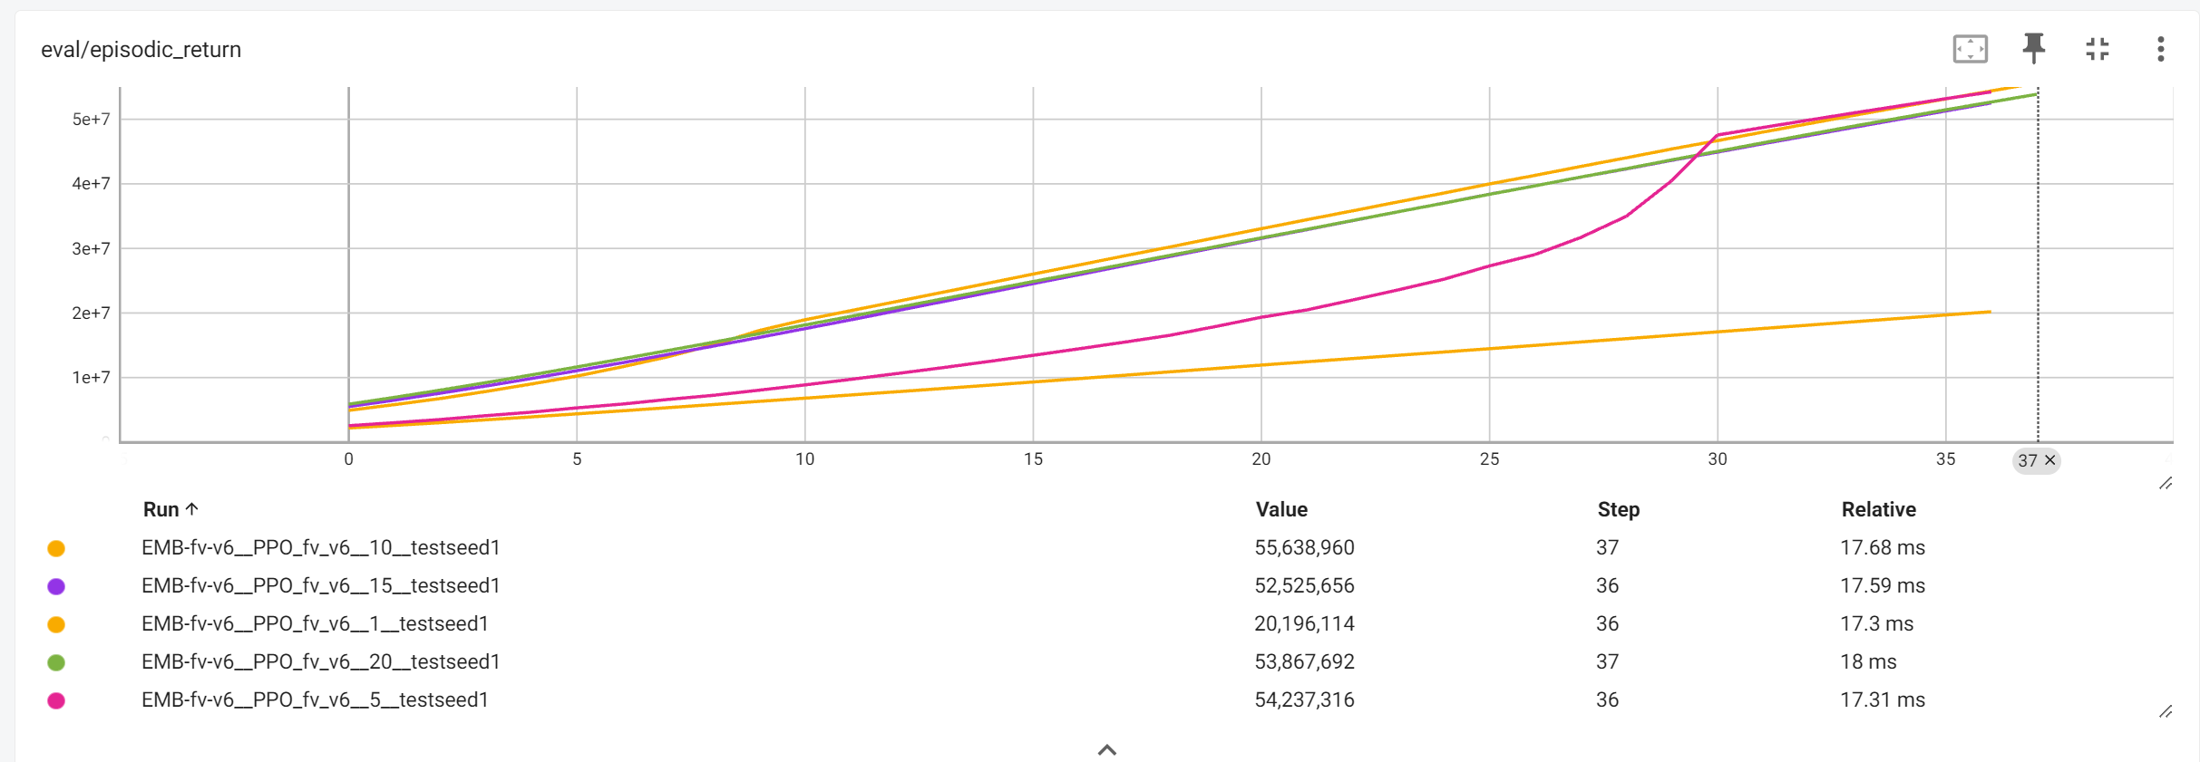
Train 5 times with different seed

Slide 6
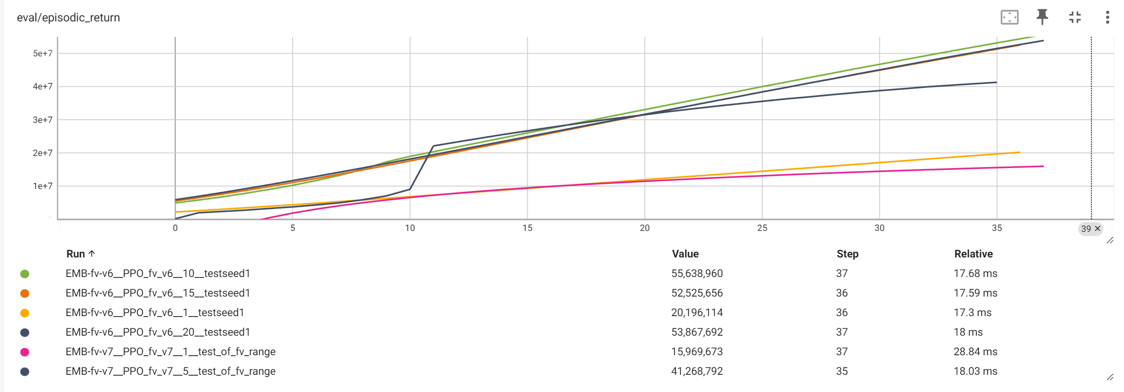
Compare the result of sampled parameter and nominal parameter
Train 5 times with different seed

Slide 7
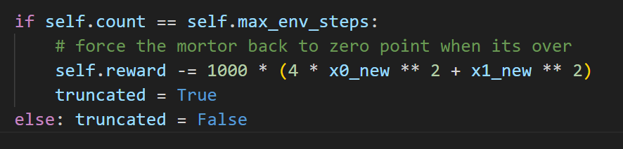
Force back to zero point
Add punishment to if the motor don’t go back to zero point at the end of the episode
This is a sparse reward, hard to train

Slide 8
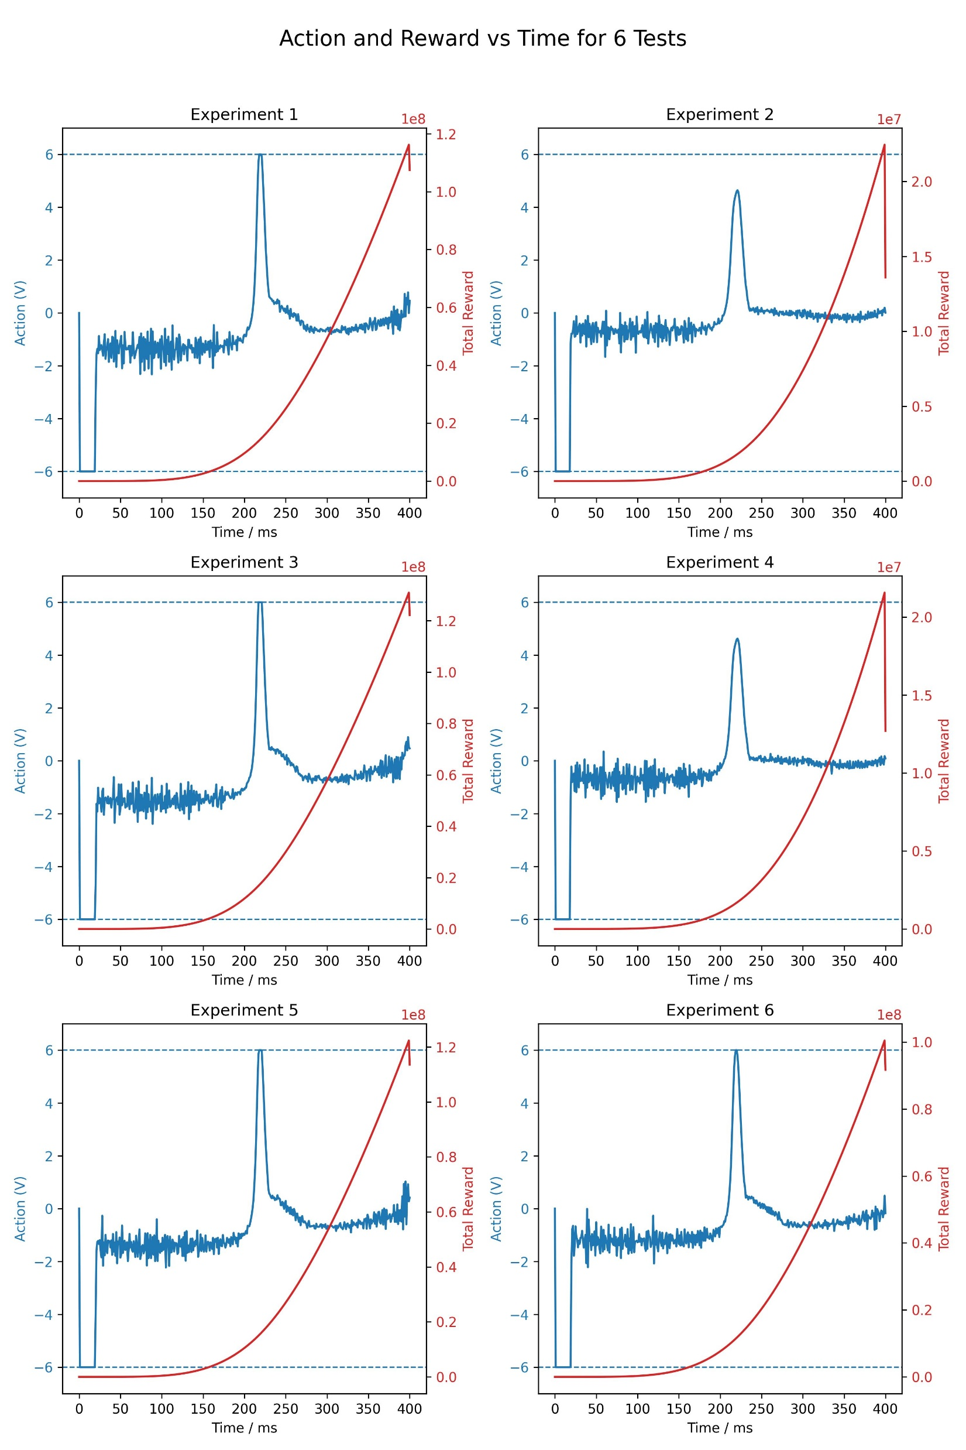
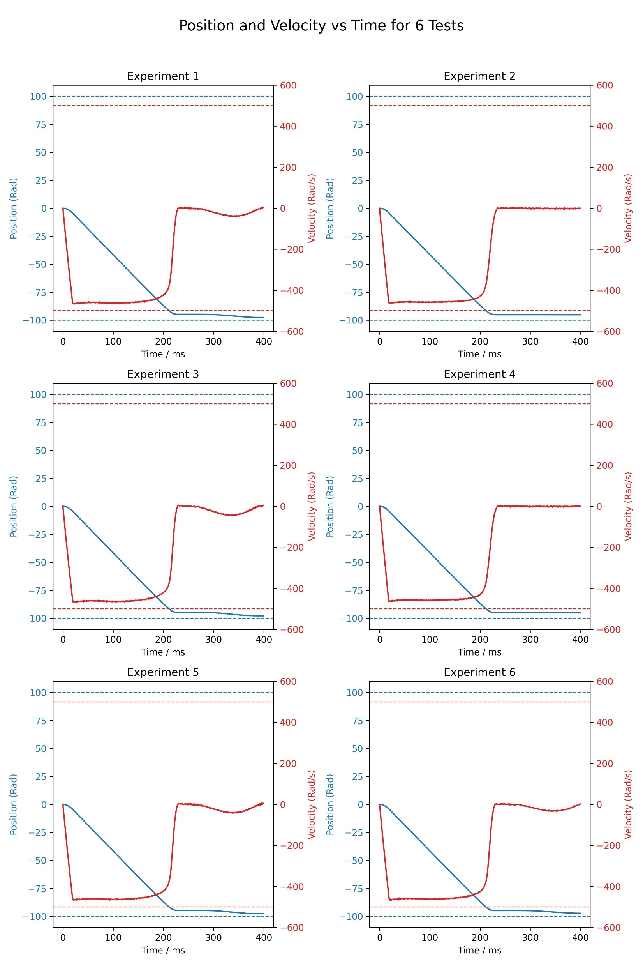
Force back to zero point

Slide 9
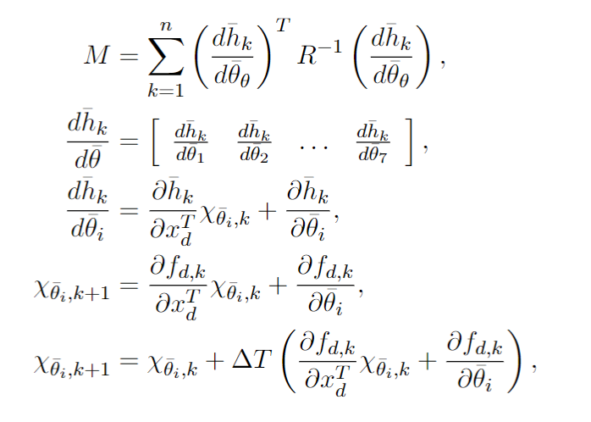
Force back to zero point
Reward keep a growing even the speed is 0 after 200ms

Slide 10
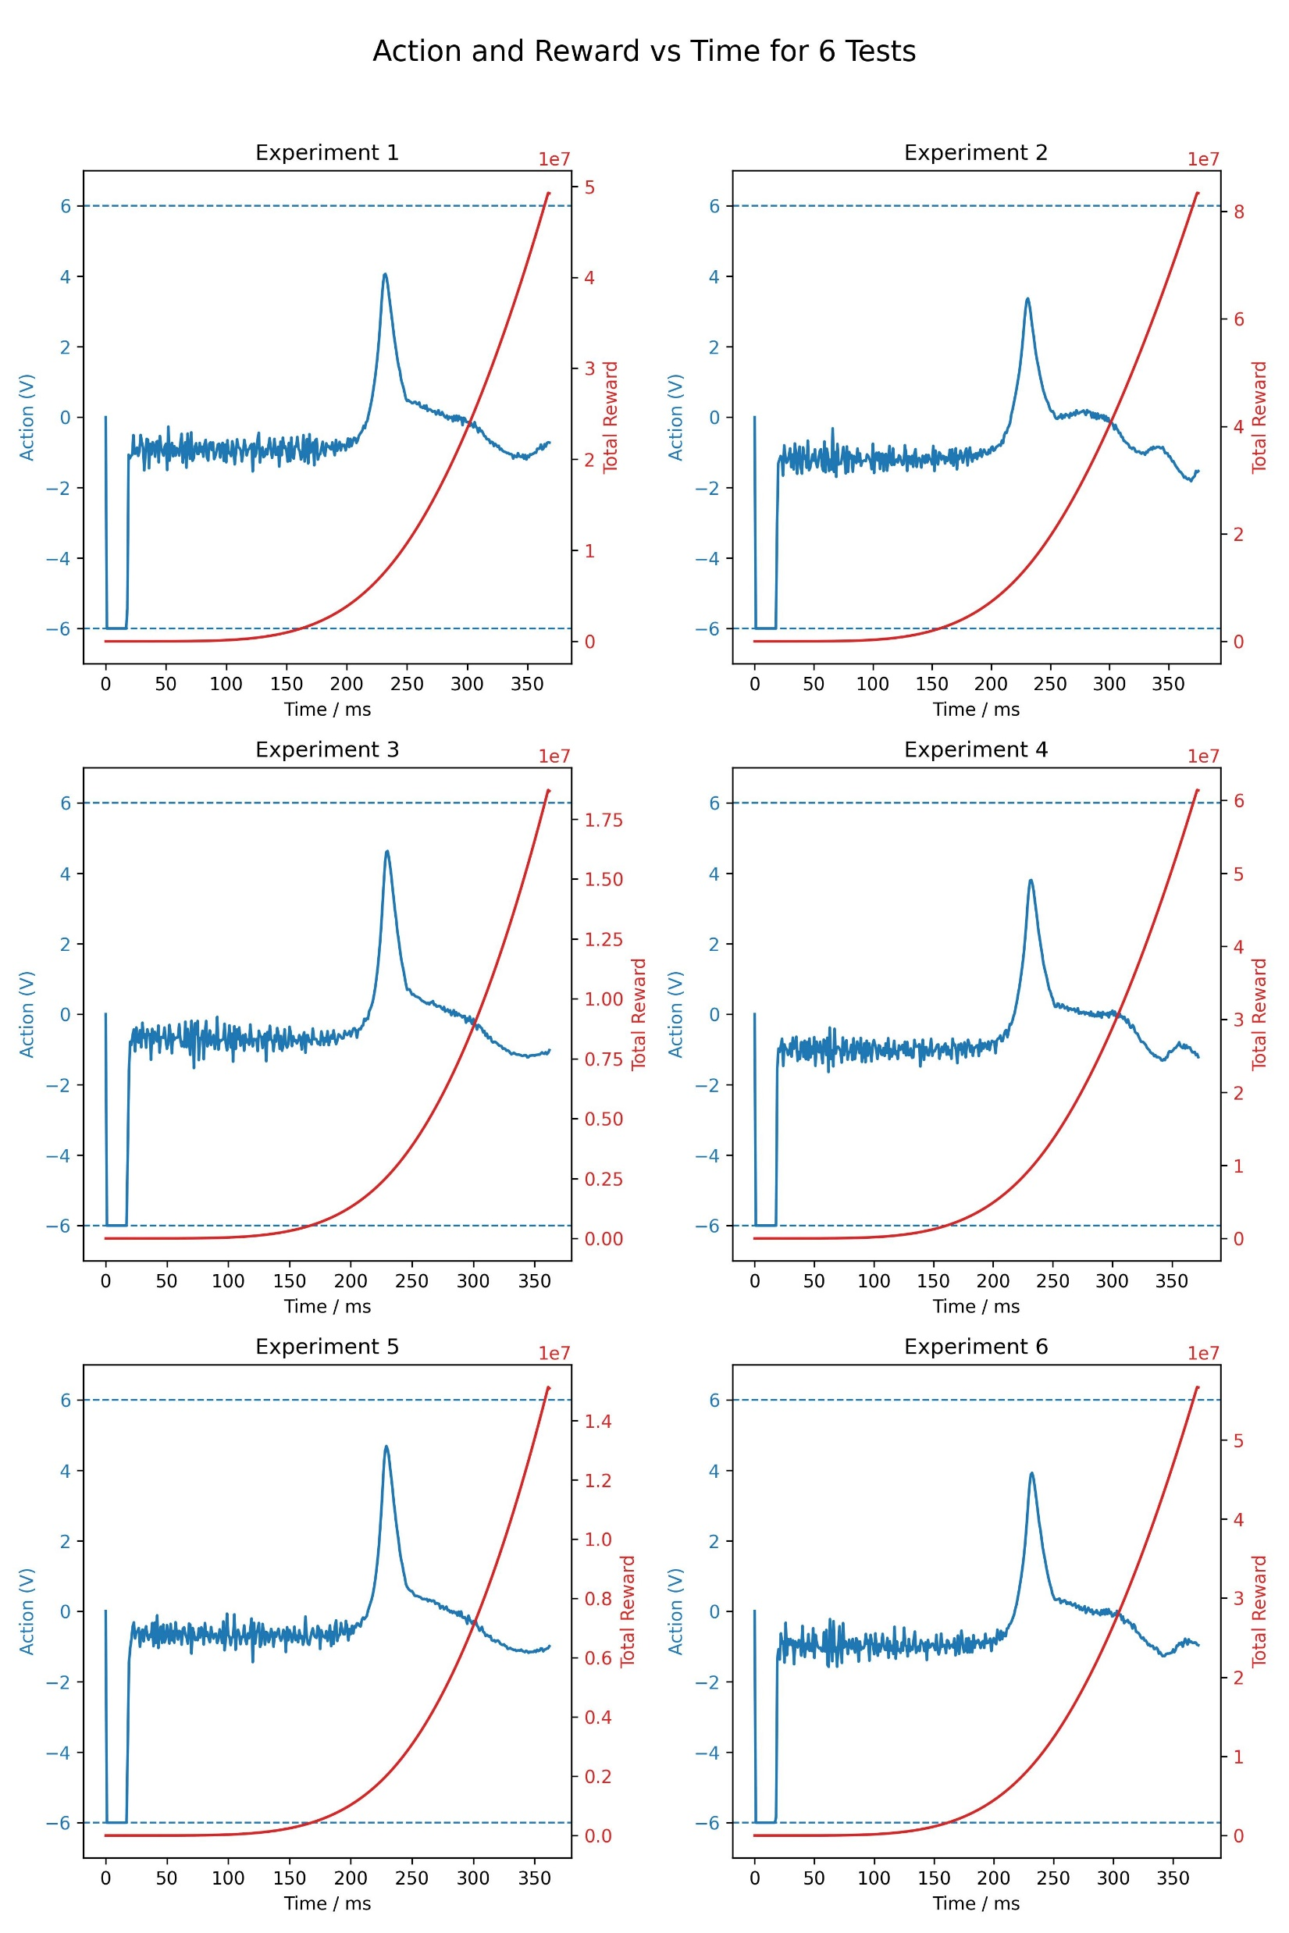
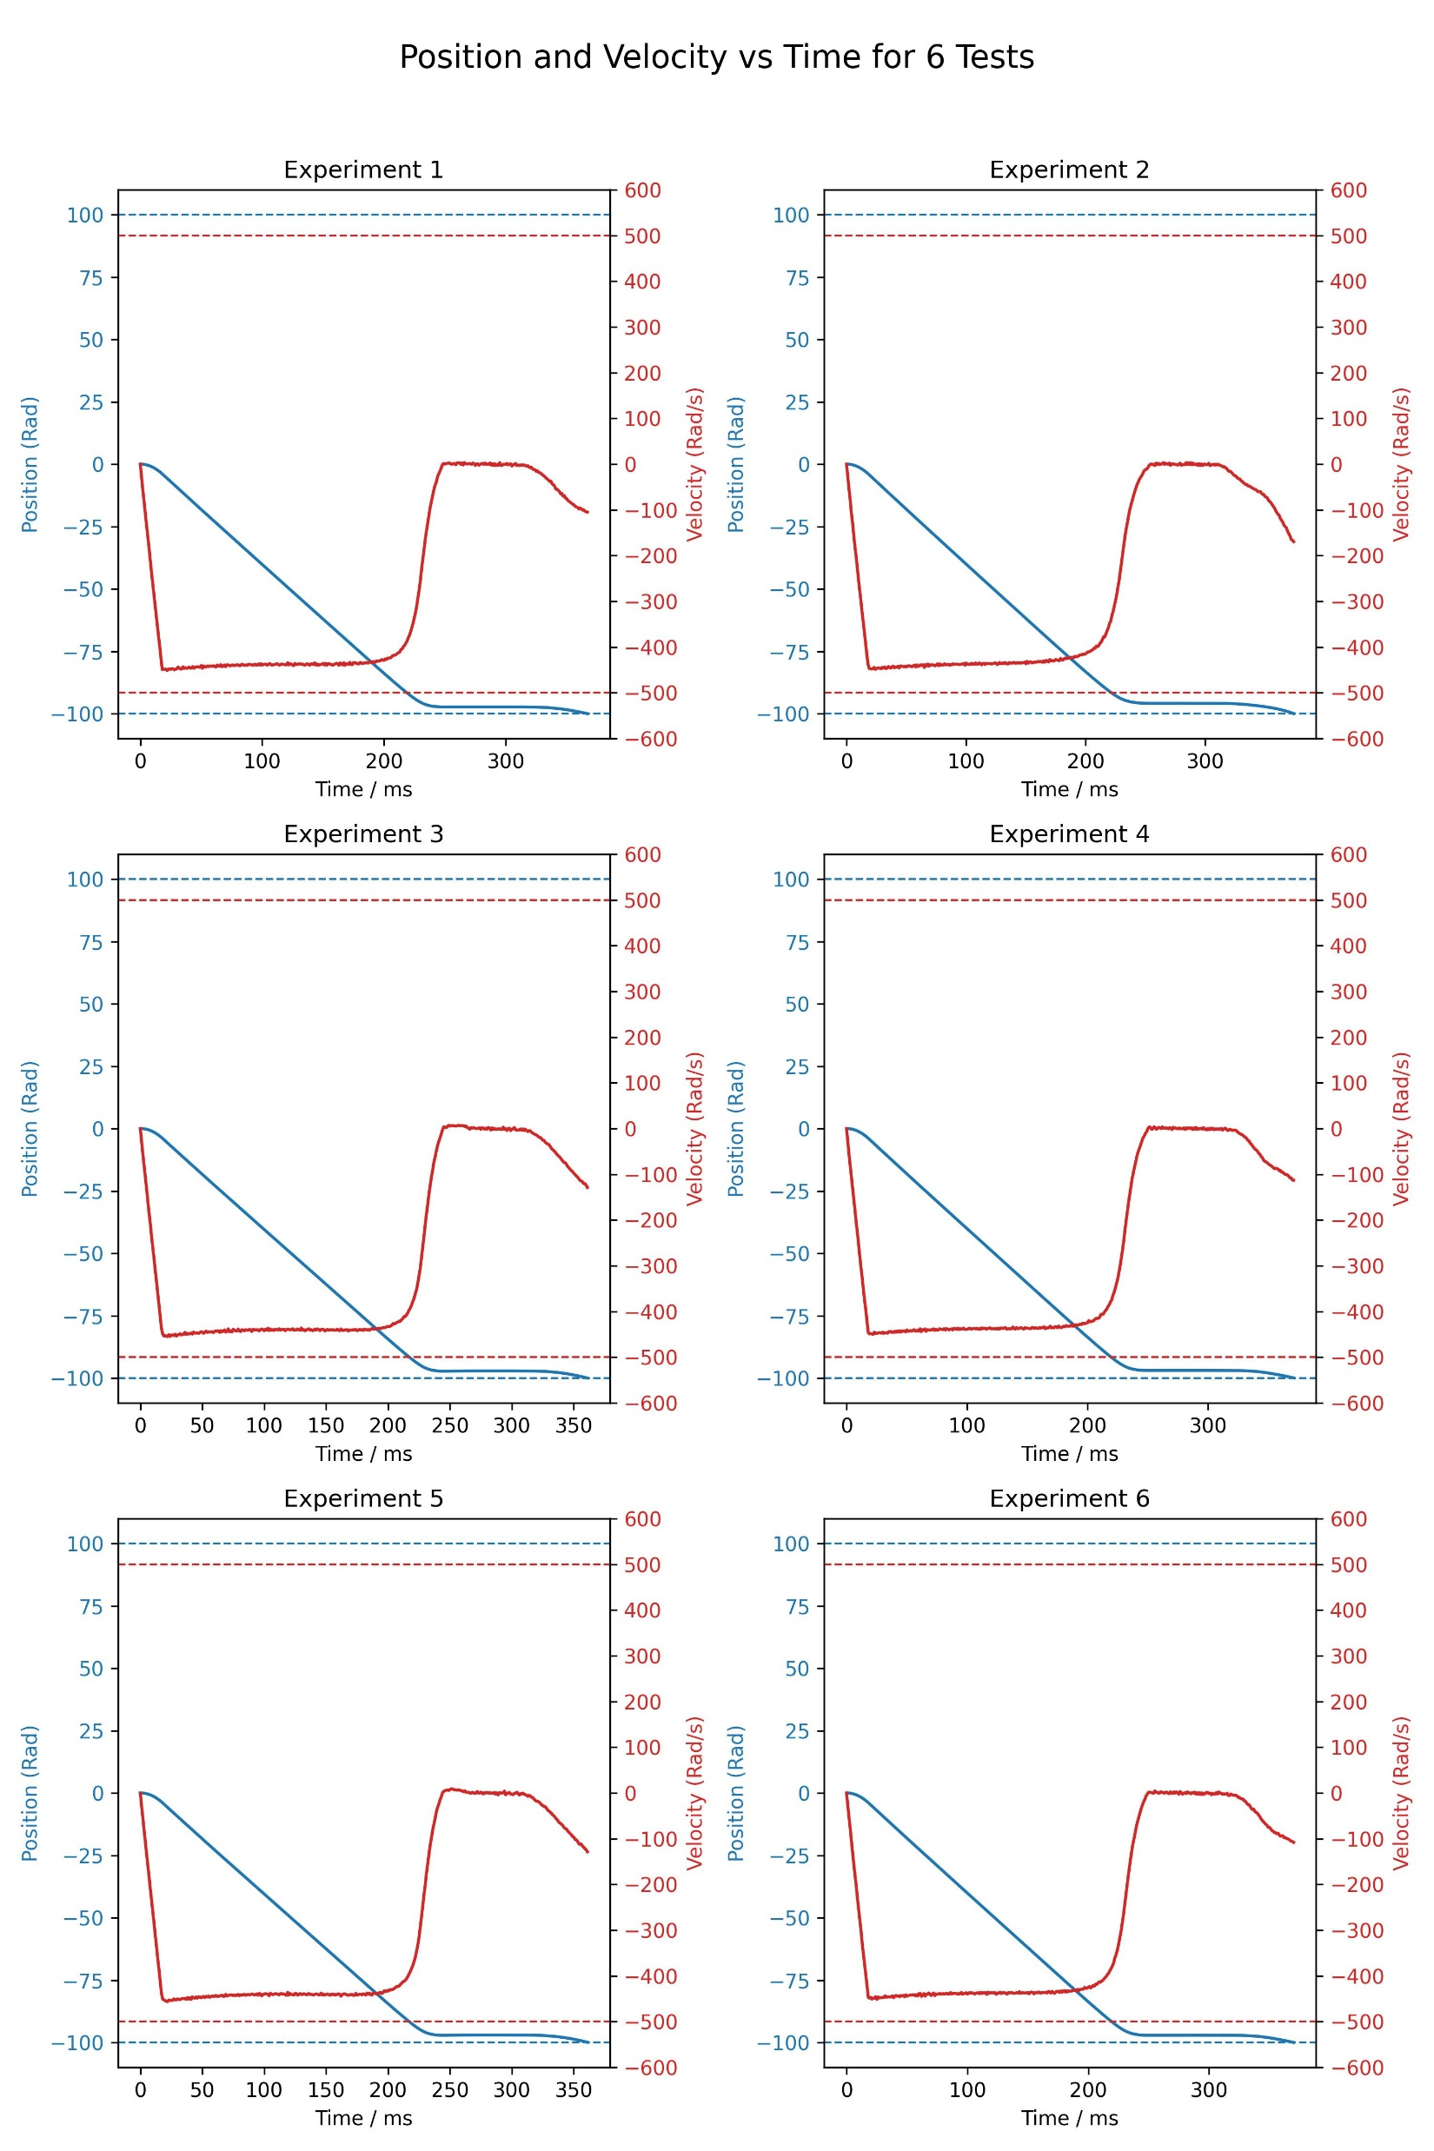
Force back to zero point
1. Enhance the punishment of the position

Slide 11
Next
1. Draw the basic input to compare with
2. Explain specifically how the FIM get exploration when speed is 0
3. No sparse reward for the punishment for zero point, use (1-k/k_max)^2 * R - (k/k_max)^2 * P
4. Change the pos range to (-10,100)
5. Next step: train the PPO, with actor input (x1_nosie, x2_nosie, k), critic input (x1, x2, k, fv, FIM)
6. LSTM?

